Slide 1

Investigating Correlations Among Traffic Flow Characteristics, Air Pollution, and Meteorological Factors on Urban Freeways
Master’s Thesis Presentation
Presented by: Xuqing (Vivian) Liang
Date & time: May 14, 2021, 8:00 pm
Committee Members: Dr. Xinkai Wu, Dr. Yongping Zhang & Dr. Wen Cheng
Notes:
Good evening everyone. My name is Vivian Liang. Thank you for attending the presentation of my master’s thesis. I really appreciate your time and interest in this topic. Before I start giving this presentation, I would like to let you know that the slide number are provided at the bottom of each slide so that you can refer to them during the Q&A time if you have any questions regarding any figures and tables. So, let’s begin with my thesis title, which is investigating correlations among traffic flow characteristics, air pollution, and meteorological factors on urban freeways.

Slide 2

Outline
Introduction
Background
Data Description
Statistical Analysis
Prediction Models
Concluding Remarks
Notes:
So, in this presentation, I will give an introduction and a brief background about some key elements within my thesis. Then I will elaborate our dataset followed by a correlation analysis. Based on our existing knowledge and purposes, we refine our data and perform prediction modeling. Finally, we come to the conclusion of our findings, some limitations, and future directions beyond this topic.

Slide 3

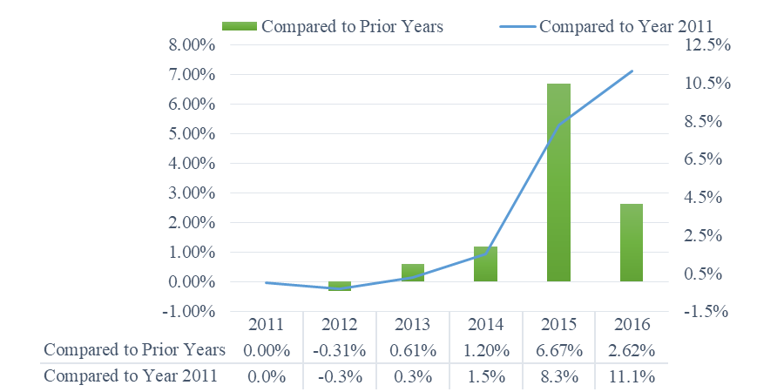
Introduction
Combustion of fossil fuels for road transport has been one of the most significant sources of air pollution and greenhouse gases in the United States.
Traffic-induced air pollution have negative impacts on human-health, environmental, and economic aspects.
There has been a growing trend in traffic demand over years.
Three datasets were jointly used to perform a correlation analysis and conduct predictive models. All data were collected all year round in 2019.
Comparison of annual vehicle miles traveled on California state highways
Notes:
The United States is well known for the Interstate Highway System, which is a large-scale integrated network of controlled-access highways spanning the whole country. Many studies have shown that the fossil fuel burning for road transport is one of the most significant sources of air pollution. Traffic-induced air pollution have negative impacts on human health, the environment, and economics overall. This issue is more vital to metropolitan cities due to the tremendous traffic volume and traffic congestion that they have to deal with on a daily basis. However, the traffic demand is still rapidly growing over years, prior to the spread of COVID-19. As you can see from the figure below, the data obtained from Caltrans’ report indicates that the annual vehicle-miles traveled on California state highways was increased by 11% in 5 years, from year 2011 to 2016. Therefore, in this thesis, we aim to analyze the potential relationship between traffic and ambient air pollution under varying weather conditions by using year-round data of 2019. Three datasets were jointly used to perform a comprehensive correlation analysis and to conduct predictive models.

Slide 4
Classification of Pollutants
Pollutant | Primary | Secondary | General Formation Process
CO | Yes |  | A small amount of carbon is emitted as CO due to the incomplete combustion process of fossil fuel.
CO₂ | Yes |  | Most of the carbon in fuel is emitted as CO₂.
NO | Yes |  | NO is formed when N₂ reacts with O₂.
NO₂ | Yes | Yes | NO₂ can be formed from fuels burned at high temperatures or oxidation (reacting with O₂ or O₃) of NO.
PM2.5 | Yes | Yes | Fine PM is emitted directly from natural and anthropogenic sources.
Ground-Level O₃ |  | Yes | O₃ is formed by chemical reactions between NO_{x} and VOCs in the presence of sunlight.
Notes:
Let’s move on to the problematic pollutants involved in this study. We have carbon monoxide, carbon dioxide, nitric oxide, nitrogen dioxide, PM2.5 and ground-level ozone here. And based on how they are produced and emitted into the atmosphere, they can be classified as primary or secondary pollutants. Primary pollutants are those produced directly from a source and emitted into the air, while secondary pollutants are formed when other pollutants undergo chemical reactions. One can be both primary and secondary pollutants, such as NO2 and PM2.5. In addition, a significant number of existing studies have confirmed the interconvertibility of NO, NO2 and O3 in photochemical smog reactions, which might imply complex correlations among their concentrations.

Slide 5
Overview
Source-Sink Relationship of Air Pollution
Source
Source
State of Atmosphere
Dispersion
Sink
Receptor
Response
Human
Sensors
Environment
Health Effects
Environmental Pollution
Economics
Configuration
Rate
Transportation
Power Generation
Factories
Transformation
Removal
Wind
Turbulence
Chemical Reactions
Settling
Impaction
Scavenging
Notes:
Here we have a diagram of the source-sink relationship, reflecting how traffic, air pollution, and meteorology can be correlated. In general, air pollution sources can be described in many aspects. Burning fuels for transportation, power generation and so on, is one of the major sources which we already mentioned previously. In addition, the emission rates of air pollutants are associated with the efficiency of fuel combustion in vehicle engines, which traffic conditions could potentially influence. After the pollutants are emitted into the atmosphere, they begin to move and this is when meteorology, also known as the science of weather, come into play. For instance, the wind can help with the dispersion of pollutants, and high outdoor temperatures facilitate some chemical reaction processes of pollutants. In the end, the pollution sink can be represented by receptors and response. In this thesis, it would be air quality monitors which are used to measure the pollution concentrations. As you can see in this big picture, the process of air pollutants from being produced to being received is very complicated that it involves many systems and scientific disciplines.

Slide 6
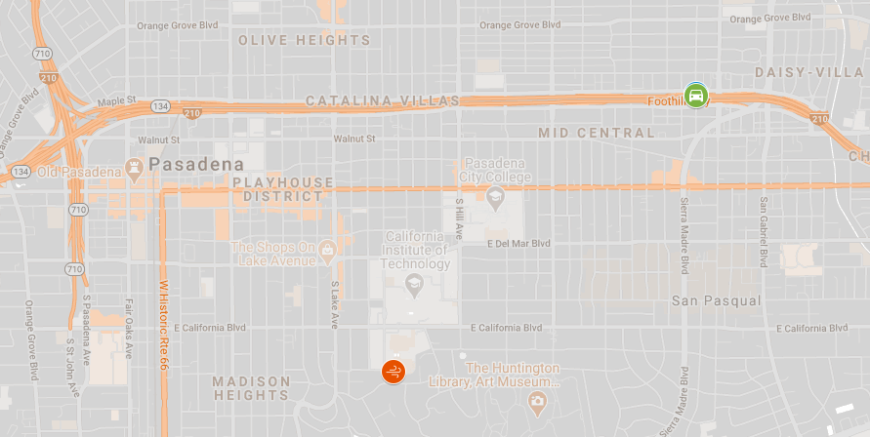

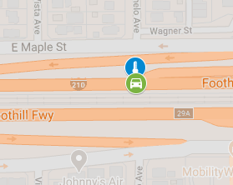
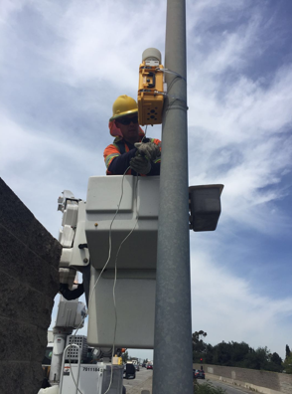
Data Overview and Collection Site
Traffic Data - PeMS
Hourly total flow (vehicles/hour)
Speed (miles/hour)
Hourly truck flow (vehicles/hour)
Air Pollutant Data - Air Monitoring Unit
CO2 (ppm)
NO2 (µg/m^3)
Wind Data - EPA Stations
Wind speed (Knots)
Density (vehicles/mile)
CO (mg/m^3)
NO (µg/m^3)
Wind direction (degree)
I-210 Freeway
N. Altadena Dr.
On-Ramp
710 Freeway
O3 (µg/m^3)
PM2.5 (µg/m^3)
Relative humidity (%)
Temperature (F)
Notes:
A segment of the I-210 freeway in the city of Pasadena, California was selected to be our study area since we aim to examine the relationships between traffic and air pollution at freeway levels. Our integrated data, which was collected over the span of a year, comes from three sources. First of all, the traffic data was obtained from PeMS. Shown as the green icon in the map, the specific loop detector station is located on the mainlines of the I-210 westbound next to the North Altadena drive. The traffic-related variables analyzed in this thesis are the hourly flow, density, speed, and hourly truck flow. The air data was collected by a research team at Cal Poly Pomona, by deploying an air monitoring unit on a CCTV pole at the roadside of the I-210 freeway, represented by the blue icon. The air monitoring unit is able to measure the concentrations of CO2, CO, NO2, NO, O3, PM2.5, relative humidity, and temperature for every 2 minutes. We transformed the 2-minute data into 1-hour data by taking the average value of observations in the same hour interval. Last but not least, we collected wind properties including hourly wind speed and wind direction from the environmental protection agency known as EPA. The EPA station is about 2miles away from the data collection point of traffic and air, so it is still very close and therefore reliable in terms of the wind data. So, this is the overview of our dataset and the attributes.

Slide 7
Traffic – Daily Patterns
Total flow
Weekday peak: 5am – 6pm
Weekend peak: 10am – 6pm
Truck Flow
Weekday Peak: 8am – 1pm
Density
Weekday peak: 7 – 9am, 4 – 6pm
Speed
Weekday lows: 7 – 9am, 4 – 6pm
Notes:
Before assessing the correlations among those variables, we first analyze the features of each variable. Starting from traffic parameters, we grouped all the data into weekdays or weekends based on the day of the observations and then took the mean values for each hour of the day. Here are the time series plot of the mean values for flow, truck flow, density, and speed, with weekday values in blue and weekend value in yellow. As you can see that the weekend traffic established a different daily pattern compared to the weekday traffic that all the lines are relatively smooth even during the normal peak hours. The weekday traffic fluctuated more dynamically throughout the day. The hourly flowrate remained high from 5 am to 6pm and reached its daily peak at 6am. We could also clearly recognize the morning peak hours from 7 to 9 am and the afternoon peak hours from 4 to 6 pm from the density plot and the speed plot.

Slide 8
Pollutants – Daily Patterns
CO2: reach its daily low point before sunrise and high point around 5pm
NO2: high at morning hours and low in the afternoon
PM2.5: relatively low in the afternoon
Note: the measurements during 12 – 1am might be abnormal due to the daily calibration process of the air monitoring unit.
Notes:
Next, we analyze the daily patterns of air pollutants using the same method. However, the observations of pollutants during 12 to 1 am appear to be abnormal because the daily calibration of the air monitoring unit automatically takes place in this time interval. Other than that, we observed that the CO2 concentrations reached its daily low point around 5 to 6am and gradually rise to the peak at 5pm. On the contrary, NO2, O3, and PM2.5 concentrations tended to be lower in the afternoon during traffic peak hours. A decline of concentrations during daytime is clearly observed in the NO2 plot which is in red. Meanwhile, we did not find any special fluctuation trends for CO and NO in respect to time of day, and we did not find these patterns of pollutants similar to those of traffic parameters.

Slide 9
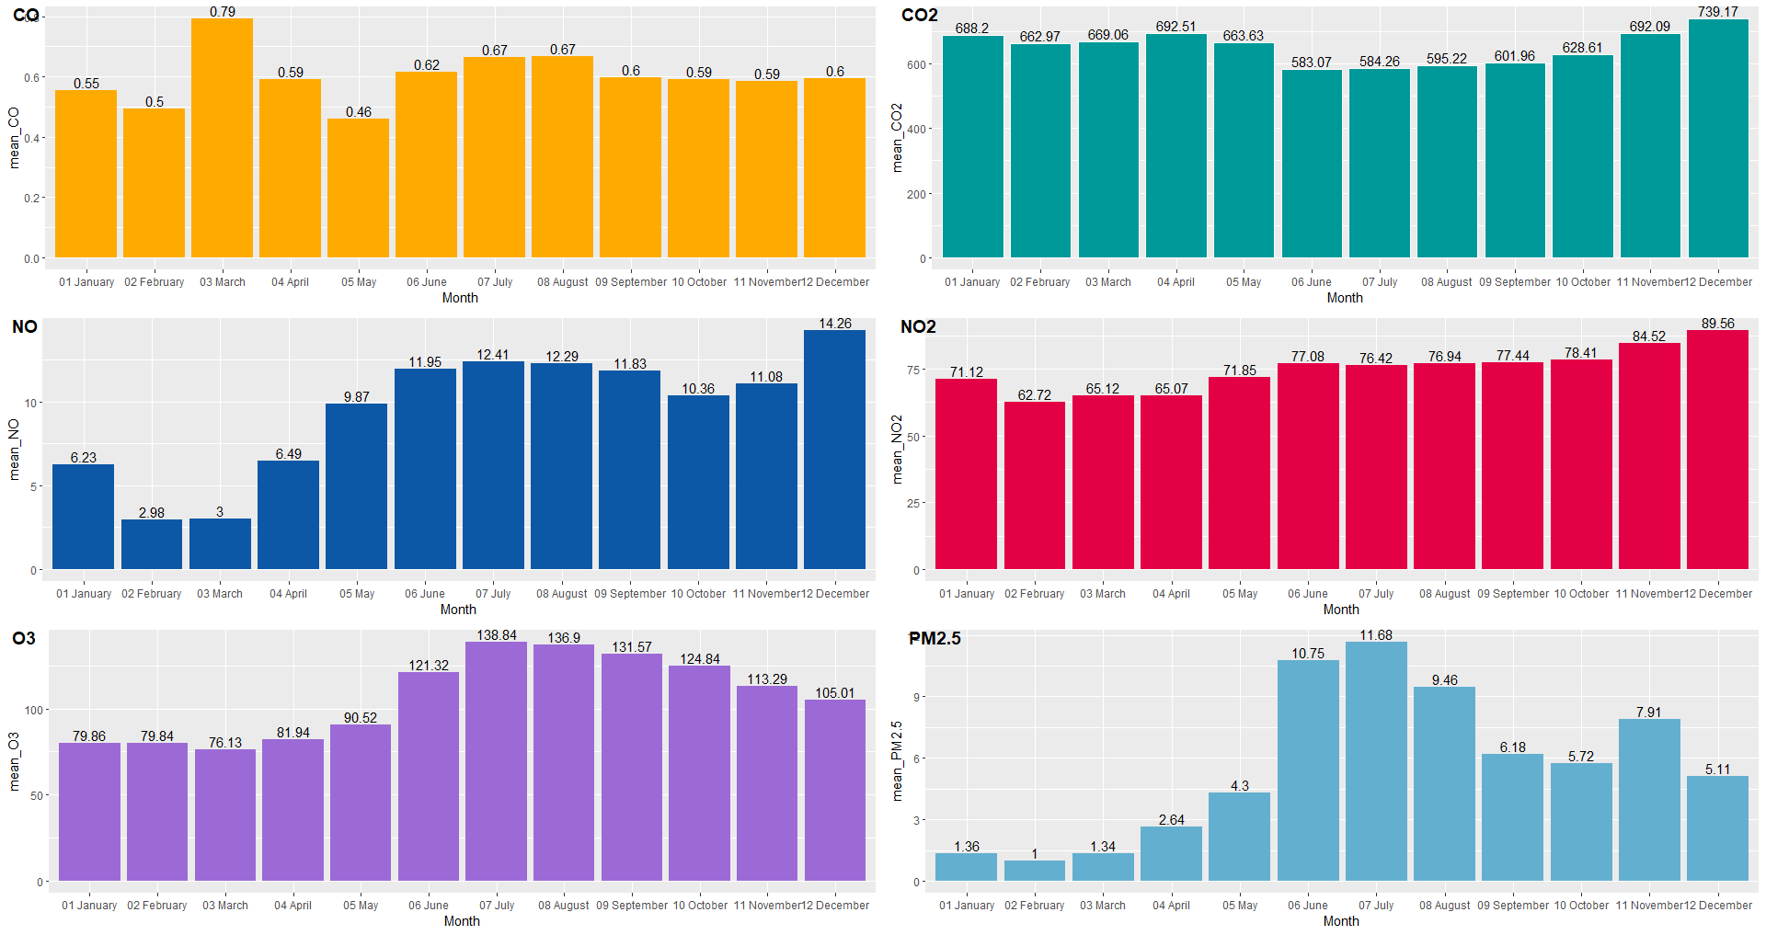
Pollutants – Seasonal Pattern
CO: NA
NO: extremely low in Feb and Mar
O₃: rise during summer months
CO₂: higher during winter and spring months
NO₂: high in Nov and Dec; low from Feb to Apr
PM2.5: extremely high from Jun to Aug
Notes:
In the next step we looked into the mean concentration values of each pollutant by each month in order to find out some seasonal patterns if there is any. A seasonal pattern of CO is not obvious; CO2 tended to be higher during the winter and spring months; NO appeared to be extremely low in February and March; NO2 were also lower in spring and increased till the end of year. O3 concentrations were clearly higher during summer months and so were those of PM2.5. Among these plots, O3 established the most significant seasonal patterns and further confirmed that it is highly associated with temperature.

Slide 10
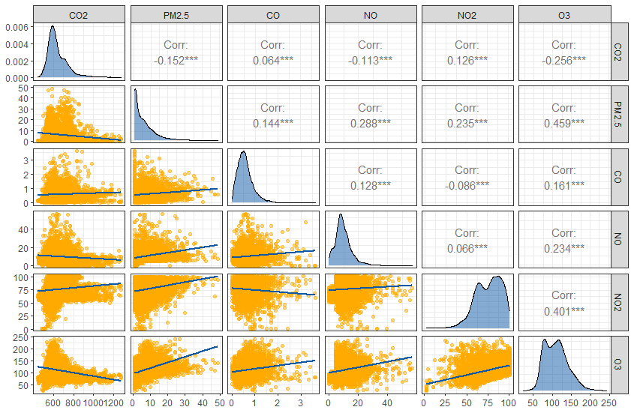
Intercorrelation - Pollutants
Moderate correlations:
O3 – PM2.5
O3 – NO2
Slight correlations:
O3 – CO2 (negative)
O3 – NO
NO – PM2.5
Notes:
Now that we have some basic understanding of our traffic data and air data, we can go on to analyze the correlations between all variables. In this correlation matrix made from the air data, in which the diagonal shows the density plot of each pollutant, the bottom and the top show the scatter plots and corresponding correlation values of each pair of variables, we observed some moderate and positive relationships such as O3 to PM2.5 and O3 to NO2 because their correlation values are higher than 0.4. we also found out that O3 to CO2, O3 to NO, and NO to PM2.5 imply slight correlations. The remaining pairs suggested little correlations since the values are very close to zero.

Slide 11
Correlation – Pollutants vs. Traffic and Meteorology
No significant and direct correlations between pollutant concentrations and traffic flow parameters
 | Flow | Density | Speed | Small | Heavy | RH | TEMP | WS
CO2 | -0.020 | -0.020 | 0.006 | -0.020 | -0.024 | 0.055 | -0.236 | 0.037
PM2.5 | 0.017 | 0.052 | -0.057 | 0.016 | 0.019 | 0.354 | 0.002 | -0.021
CO | 0.059 | 0.065 | -0.061 | 0.058 | 0.052 | -0.245 | 0.347 | 0.013
NO | 0.048 | 0.048 | -0.045 | 0.050 | 0.014 | 0.086 | 0.044 | -0.034
NO2 | -0.047 | -0.030 | 0.018 | -0.048 | -0.017 | 0.676 | -0.724 | -0.083
O3 | 0.070 | 0.089 | -0.092 | 0.067 | 0.080 | 0.297 | -0.005 | -0.019
Relative humidity has moderate to strong correlations with PM2.5, NO₂, and O₃.
Temperature is positively associated with CO and negatively related to NO₂.
Notes:
We also computed the correlation values between pollutant variables and non-pollutant variables. So far in this table, it is suggested no significant and direct correlations between the concentrations of any pollutant and traffic flow parameters. Relative humidity has moderate to strong correlations with PM2.5, NO₂, and O₃. Temperature is positively associated with CO and negatively related to NO₂. Computing correlation value is the simplest and most direct method of assessing correlations between two variables because it only evaluates if the variation of one variable can be fully explained by another variable. That is why we applied regression models on our data to find out if the variation of response variable, which in our case is the pollutant density, can be partially explained by multiple explanatory variables altogether.

Slide 12
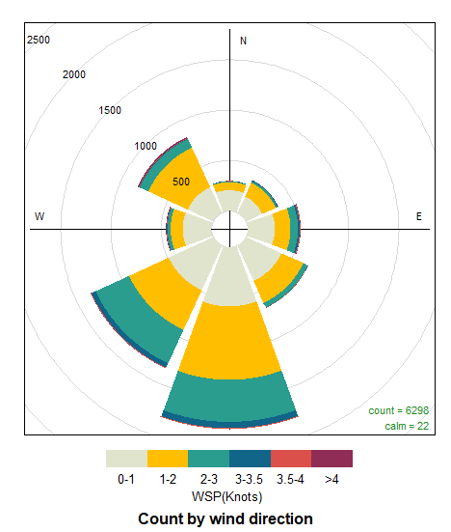
Wind Properties
The majority of wind throughout the year came from the south and southwest directions.
Wind plays a critical role in the dispersion and diffusion process of air pollutants.
Notes:
Finally, we analyze the wind properties using the wind rose plot showing the counts of wind occurrence at different speed levels with these paddles representing the wind directions. As you can see that the majority of wind in our study area throughout the year came from the south and southeast directions at relatively low speeds. The topography of our study area could be an influencing factor of wind properties, but it is not in our scope of study. As previously mentioned, wind, which is a vectorial variable, plays a critical role in the dispersion and diffusion of pollutants both horizontally and vertically. However, we decided to omit the wind direction variable for regression modeling since the inputs of regression models should be all quantitative.

Slide 13
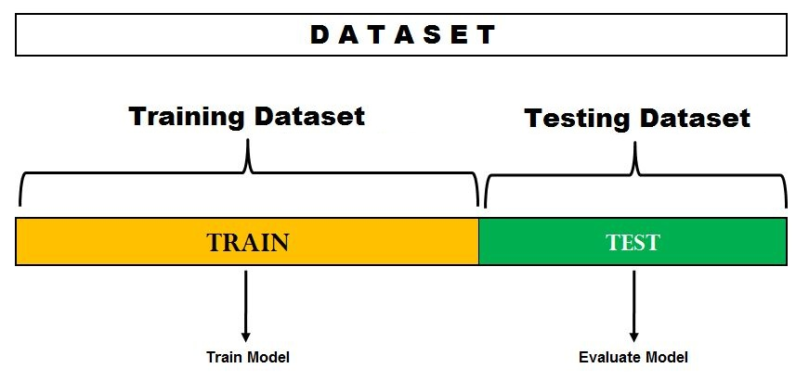

Prediction Models
Our data samples were narrowed down to those collected on weekdays from 5am to 8pm.
Three regression models and one machine learning algorithm are applied to predict the hourly concentrations of air pollutants under the influence of traffic and meteorology:
Multiple Linear Regression
Stepwise Regression
LASSO Regression
Artificial Neural Network (ANN)
Performance Metrics:
External R^2
Root Mean Squared Error (RMSE)
Formula to normalize data between 0 and 1:
$$A_{n}^{′}=\frac{A_{n}−A_{min}}{A_{max}−A_{min}}$$
70% 30%
Notes:
Now I am going to talk about the prediction models. Since theoretically, the more traffic, the more pollutant emissions from the vehicles, and the core focus of this thesis is to investigate the variation of pollutant densities especially in heavy traffic conditions, we decided to narrow our data samples down to those collected on weekdays from 5am to 8pm. And as mentioned previously, we applied three statistical regression models, including multiple linear regression, stepwise regression, and LASSO regression, as well as one machine learning algorithm named artificial neural network to estimate the concurrent concentration of pollutants and to find out if traffic parameters are statistically significant to pollutant emissions. Since each variable in the data are highly diverse in scale, the first step was to apply a min-max scaling to our dataset to make their values comparable while preserving the shape of each variable’s distribution. Thus, our data was normalized between 0 and 1. The second step was to split our dataset into training dataset and testing dataset. It is a simple cross validation process in which we build the models using the training data, which in our case constitutes 70% of total samples, and then we run the models with the testing data to estimate the accuracy. In the end, we compare the performance of four models using the external R^2 and Root Mean Squared Error.

Slide 14
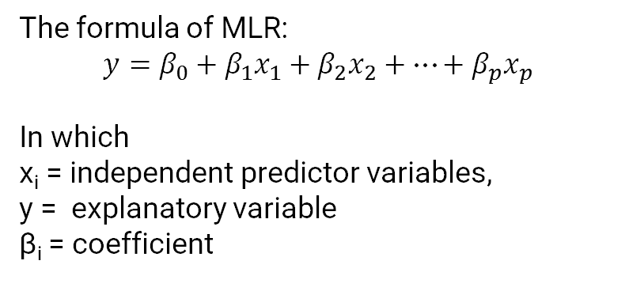
Multiple Linear Regression Model
The formula of MLR:
$$y=β_{0}+β_{1}x_{1}+β_{2}x_{2}+…+β_{p}x_{p}$$
In which
x_{i} = independent predictor variables,
y = explanatory variable
β_{i} = coefficient
 | CO | CO2 | NO | NO2 | O3 | PM2.5
Intercept | -0.1150 | 0.3310 | 0.1544 | 0.6453 | -0.2536 | -0.2176
Density | -0.0107 | -0.0784 | -0.0161 | 0.0215 | -0.0385 | -0.0360
Speed | -0.0129 | -0.0696 | -0.0333 | 0.0142 | -0.0345 | -0.0461
Small | -0.0089 | -0.0085 | 0.0160 | -0.0045 | -0.0070 | -0.0753
Heavy | -0.0094 | -0.0071 | -0.0415 | 0.0048 | 0.0079 | 0.0020
CO2 | 0.1721 |  | -0.0230 | 0.0601 | -0.2013 | -0.0486
PM2.5 | 0.1094 | -0.0423 | 0.1419 | 0.0427 | 0.1569
CO |  | 0.2420 | 0.0547 | 0.2212 | 0.0468 | 0.1767
NO | 0.0505 | -0.0299 |  | 0.0048 | 0.0677 | 0.2117
NO2 | 0.2715 | 0.1036 | 0.0064 |  | 0.5517 | 0.0847
O3 | 0.0474 | -0.2868 | 0.0743 | 0.4555 |  | 0.2569
RH | -0.1129 | -0.0239 | -0.0193 | 0.0752 | 0.1055 | 0.2820
TEMP | 0.2666 | -0.1363 | -0.0145 | -0.5868 | 0.4327 | 0.2819
WS | -0.0668 | 0.0420 | -0.0378 | 0.0184 | -0.0137 | -0.0172
Contributions
Speed-CO2: negative
Heavy-NO: negative
Small-PM2.5: negative
Notes:
The first model we applied is the multiple linear regression which uses all the input variables for prediction regardless of their statistical significance. We applied this model for each target pollutant, and the outcomes are summarized in this table. I know these numbers are so overwhelming, so I will just mainly discuss the coefficients of traffic parameters that are considered statistically significant, highlighted in green. Firstly, the model identified the speed to be negatively contributive to CO2, which implies the higher speed, the lower emission of CO2. It is interesting that the truck flow contributes negatively while non-truck flow positively to NO emissions. But since the coefficients are comparable because we already applied the scaling, it could imply that trucks make less contribution on NO emission than non-truck vehicles do. Similarly, regular passenger vehicles emit fewer particulate matters compared to trucks.

Slide 15
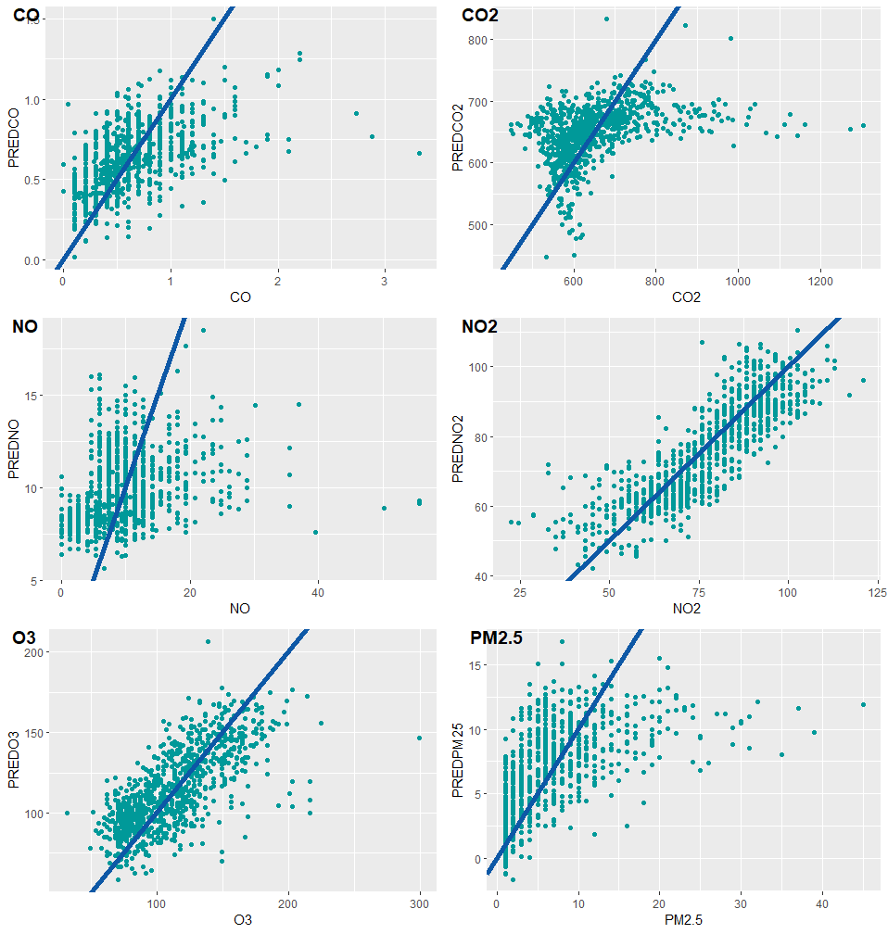
Prediction - Linear
MLM | Internal R^2 | External R^2 | RMSE
CO | 0.2613 | 0.2934 | 0.3210
CO2 | 0.1642 | 0.1625 | 97.8573
NO | 0.0861 | 0.0829 | 6.0502
NO2 | 0.7142 | 0.7160 | 8.8131
O3 | 0.5107 | 0.4876 | 23.7546
PM2.5 | 0.3639 | 0.3795 | 4.8666
NO2 and O3 models have the best predictions among all models.
Notes:
The performance of each model can be indicated by the r-squared value or by the residual plot which is a scatter plot of observed response versus the predicted response. NO2 and O3 models have better performance overall in terms of their higher r-squared values. And we can also tell from their residual plots that they have better fits.

Slide 16
Stepwise Regression Model
Three strategies of stepwise regression:
Forward selection
Backward selection
Stepwise selection
Contributions
Density-CO2: negative
Speed-CO2/PM2.5: negative
Small-PM2.5: negative
Heavy-NO/NO2/O3
 | CO | CO2 | NO | NO2 | O3 | PM2.5
Intercept | -0.1412 | 0.3136 | 0.1379 | 0.6731 | -0.2902 | -0.2618
Density |  | -0.0742
Speed |  | -0.0653 |  |  |  | -0.0227
Small |  |  |  |  |  | -0.0658
Heavy |  |  | -0.0192 | -0.0195 | 0.0455
CO2 | 0.1711 |  | -0.0324 | 0.0694 | -0.2036 | -0.0549
PM2.5 | 0.1037 | -0.0464 | 0.1337 | 0.0515 | 0.1585
CO |  | 0.2297 | 0.0569 | 0.2292 | 0.0426 | 0.1634
NO | 0.0511 | -0.0400 |  |  | 0.0645 | 0.1951
NO2 | 0.2908 | 0.1122 | -0.0252 |  | 0.0528 | 0.1039
O3 | 0.0432 | -0.2966 | 0.0762 | 0.4588 |  | 0.2739
RH | -0.1249 | -0.0195 |  | 0.0629 | 0.1140 | 0.2832
TEMP | 0.2710 | -0.1268 |  | -0.5835 | 0.4096 | 0.2795
WS | -0.0723 | 0.0429 | -0.0399
Notes:
The stepwise regression model can find the subset of variables in the dataset resulting in the best performing model with the lowest prediction errors, by iteratively adding and removing predictors. There are three strategies: forward selection starts with no predictors in the model, iteratively adds the most contributive predictors, and stops when the improvement is no longer statistically significant. Backward selection, which is applied here as my second regression model, is to start with all predictors in the model, iteratively removes the least contributive predictors, and stops when the remaining predictors in the models are statistically significant. Lastly, the stepwise selection is a combination of forward and backward selections. Therefore, in this tables, the cells left in blank indicates the insignificant contributions of those variables in the rows. It is quite interesting to find out that density negatively contributes to CO2 concentrations, but recalling the daily pattern plots in which density reached the highest daily value while CO2 reached the lowest in the morning hours, it might explain this outcome. Besides, the truck flow is identified by the stepwise regression model as contributive positively to O3 and negatively to NO and NO2.

Slide 17
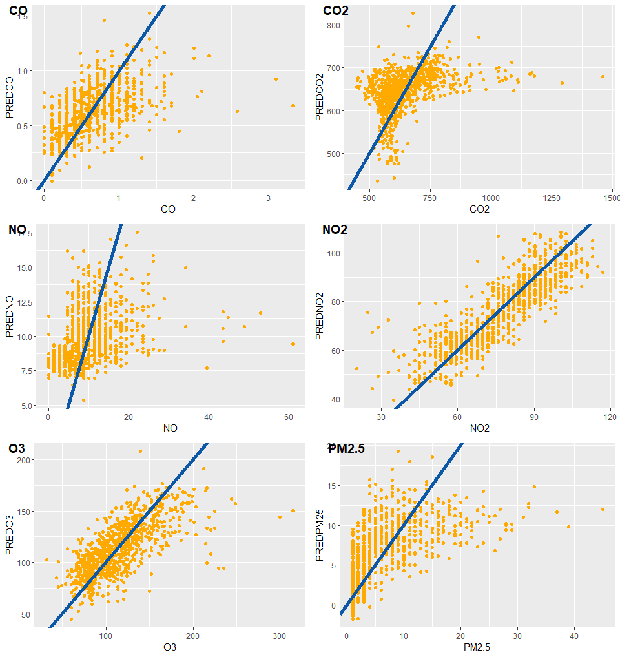
Prediction - Stepwise
STEPWISE | Internal R^2 | External R^2 | RMSE
CO | 0.2681 | 0.2795 | 0.3226
CO2 | 0.1686 | 0.1522 | 103.6653
NO | 0.0755 | 0.1044 | 6.1530
NO2 | 0.7132 | 0.1789 | 9.0093
O3 | 0.5120 | 0.4912 | 25.7676
PM2.5 | 0.3683 | 0.3799 | 4.8649
NO2 and O3 models have the best predictions among all models.
Notes:
Similar to the results and conclusions of the multiple regression models, NO2 and O3 models gave the most satisfying results among all models developed. This is not surprising because stepwise regression is substantially a linear regression applied on a subset of significant predictors selected by the model.

Slide 18
LASSO Regression Model
Least Absolute Shrinkage and Selection Operator (LASSO)
Predictors with a minor contribution to the model are penalized by shrinking their estimated coefficients to be exactly zero.
Speed-CO2/NO/PM25: negative
Small-CO2/O3/PM2.5: negative
 | CO | CO2 | NO | NO2 | O3 | PM2.5
Intercept | -0.1472 | 0.2638 | 0.1276 | 0.6575 | -0.2588 | -0.2671
Density
Speed |  | -0.0015 | -0.0066 |  |  | -0.0181
Small |  | -0.0102 |  |  | -0.0078 | -0.0442
Heavy |  |  | -0.0123 |  | 0.0221 | 0.0040
CO2 | 0.1594 |  | -0.0165 | 0.0600 | -0.2014 | -0.0253
PM2.5 | 0.1035 | -0.0278 | 0.1426 | 0.0560 | 0.1634
CO |  | 0.2091 | 0.0350 | 0.2318 | 0.0149 | 0.1563
NO | 0.0326 | -0.0231 |  |  | 0.0667 | 0.2001
NO2 | 0.2943 | 0.1013 |  |  | 0.5334 | 0.0931
O3 | 0.0225 | -0.2819 | 0.0770 | 0.4440 |  | 0.2637
RH | -0.1044 | -0.0212 | -0.0138 | 0.0713 | 0.0973 | 0.2690
TEMP | 0.2771 | -0.1231 |  | -0.5725 | 0.4083 | 0.2659
WS | -0.0530 | 0.0234 | -0.0294 | 0.0170 | 0.0347 | -0.0023
Notes:
The third regression model is LASSO which stands for Least Absolute Shrinkage and Selection Operator. In this model, predictors with a minor contribution to the model are penalized by shrinking their estimated coefficients to be exactly zero. Therefore, it can also be seen as a subset selection model in order to reduce the complexity of the model overall.

Slide 19
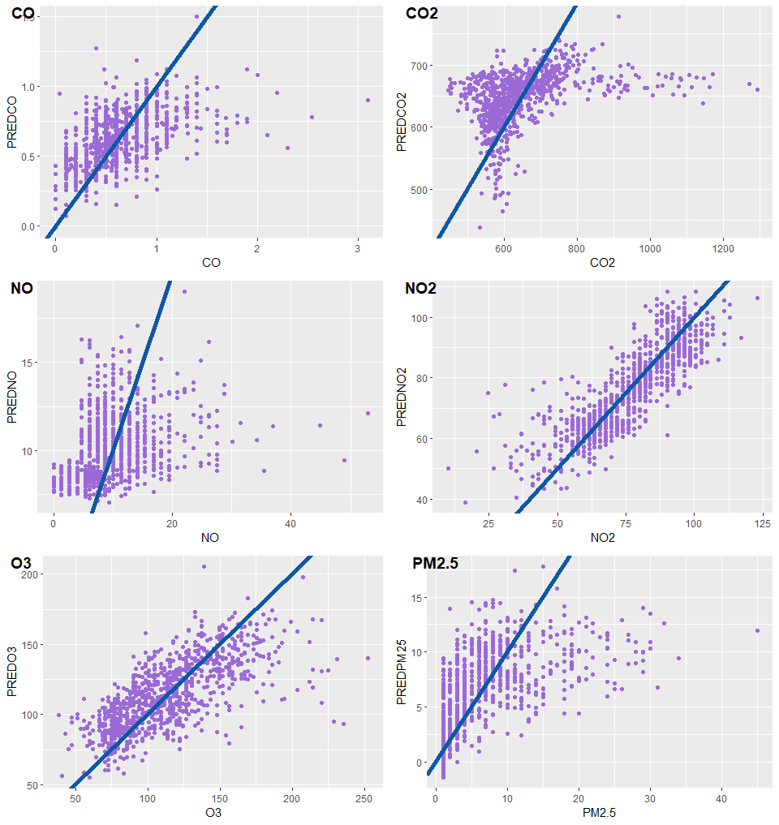
Prediction - LASSO
LASSO | Internal R^2 | External R^2 | RMSE
CO | 0.2673 | 0.2852 | 0.3088
CO2 | 0.1707 | 0.1516 | 104.9591
NO | 0.0838 | 0.0984 | 5.7335
NO2 | 0.7220 | 0.7034 | 9.2271
O3 | 0.5165 | 0.4837 | 24.8861
PM2.5 | 0.3780 | 0.3585 | 5.2219
NO2 and O3 models have the best predictions among all models.

Slide 20
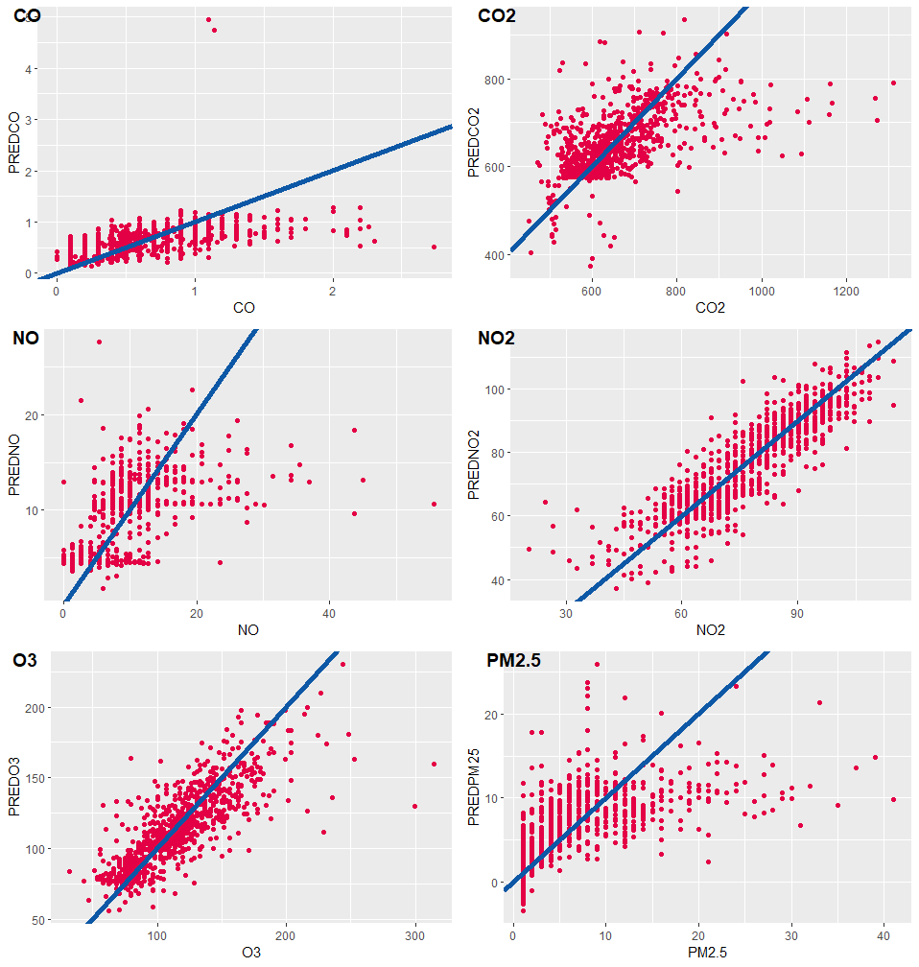
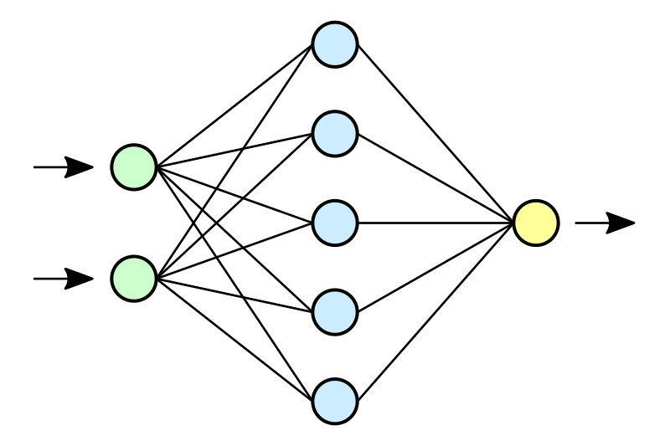
Prediction - ANN
Input
X1
X2
:
:
Xn
Output
Y
Hidden Layers
ANN | External R^2 | RMSE
CO | 0.1486 | 0.3631
CO2 | 0.3190 | 93.0229
NO | 0.2373 | 5.3126
NO2 | 0.7750 | 7.4456
O3 | 0.6473 | 21.1739
PM2.5 | 0.3793 | 5.0201
Notes:
Neural network is an information-processing machine. Just like human nervous system, which is made up of interconnected neurons, a neural network is made up of interconnected information processing units. The information processing units do not work in a linear manner. In fact, neural network draws its strength from parallel processing of information, which allows it to deal with non-linearity. However, it is complex and is often regarded as a black box, because we can view the input and output of a neural network but remain clueless about the knowledge generating process. We can see that the residual plots look quite different compared to those of previous models. The shapes of the residual plots for NO, CO2 and PM2.5 are generally improved and less scattered. But in general, the models for NO2 and O3 are still the best-performed prediction models among all.

Slide 21
Model Performance Comparison
The neural network algorithm has the best prediction outcomes in the models of CO2, NO, NO2, and O3
Model | External R-Squared: the greater, the better | external
 | CO | CO2 | NO | NO2 | O3 | PM2.5
MLM | 0.2934 | 0.1625 | 0.0829 | 0.7160 | 0.4876 | 0.3795
Stepwise | 0.2795 | 0.1522 | 0.1044 | 0.7189 | 0.4912 | 0.3799
Lasso | 0.2852 | 0.1516 | 0.0984 | 0.7034 | 0.4837 | 0.3585
ANN | 0.1486 | 0.3190 | 0.2373 | 0.7750 | 0.6473 | 0.3793
Model | RMSE: the smaller, the better
 | CO | CO2 | NO | NO2 | O3 | PM2.5
MLM | 0.3210 | 97.8573 | 6.0502 | 8.8131 | 23.7546 | 4.8666
Stepwise | 0.3226 | 103.6653 | 6.1530 | 9.0093 | 25.7676 | 4.8649
Lasso | 0.3088 | 104.9591 | 5.7335 | 9.2271 | 24.8861 | 5.2219
ANN | 0.3631 | 93.0229 | 5.3126 | 7.4456 | 21.1739 | 5.0201
Notes:
Finally, we summarize all the r-squared values and root mean squared error values into one table. By comparing the values, we conclude that the artificial neural network give the best prediction results in most of models. It produces much higher r-squared and lower RMSE values in the CO2, NO, NO2, and O3 models compared to other statistical regression models. Which, potentially imply some nonlinear relationships among traffic, air pollutant emissions and meteorological factors. The winner of prediction model goes to the LASSO regression for CO and to the stepwise regression for PM2.5.

Slide 22
Concluding Remarks
A comprehensive review of traffic-induced air pollution
Correlation Analysis
Daily pattern of air pollutants do not look similar to that of traffic parameters
Some pollutants are proven to be impacted by the seasonality.
Traffic parameters have little direct correlations with air pollutant concentrations
Relative humidity and temperature have moderate influence on pollutants in the atmospheric chemical reaction processes
Prediction
It is proven by our models that the speed has a negative impact on CO2 and PM2.5 emissions
Air pollutant: the variation of NO2 and O3 concentrations can be effectively explained by models
Model performance: ANN has the best performance in overall

Slide 23

Thank you!
Question?

